Slide 1
NRC COMMUNITY COORDINATION TOOLBOX
CCCM’s Tuesday Webinar, 6th October 2020

Slide 2
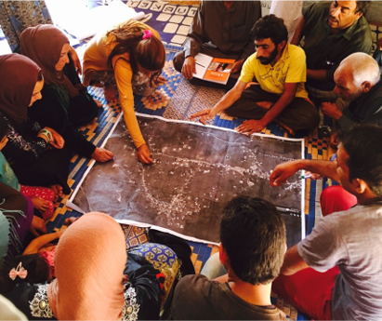
Toward a people-driven response:
A practical guide for facilitating the engagement of displaced women and marginalised groups in humanitarian planning and decision making

Slide 3
What does it mean Community Coordination?
The role that community members should have in the coordination of humanitarian services and assistance affecting their lives – being able to contribute to the collaborative process of information sharing, planning and decision making, to solve problems and address needs, and being able to liaise with a range of external stakeholders through activities such as meetings, referrals, reporting, and monitoring.

Slide 4
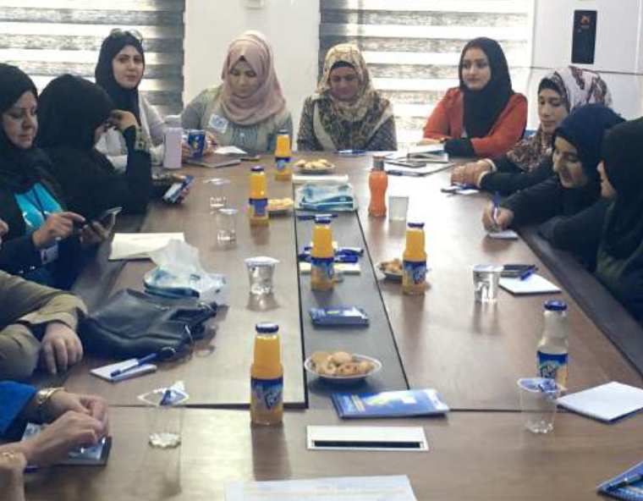
Bring the right people to the table
(accountable representation structures)

Slide 5
Building Blocks of CCT
Testing WPT in NRC UDOC programme in Afghanistan
2018
NRC Women participation research
2019
CCCM UDOC desk review
2015
Piloting and testing NRC UDOC programmes 2015-2019
Testing WPT in NRC CM programmes in Iraq
2017
IOM Women Participation toolbox 2017

Slide 6

Focus
CCCM practitioners
Women and vulnerable groups
Urban neighbourhoods

Slide 7
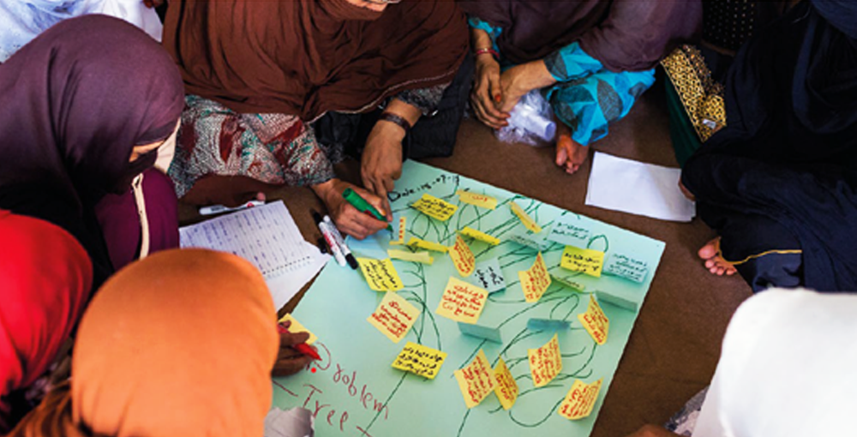
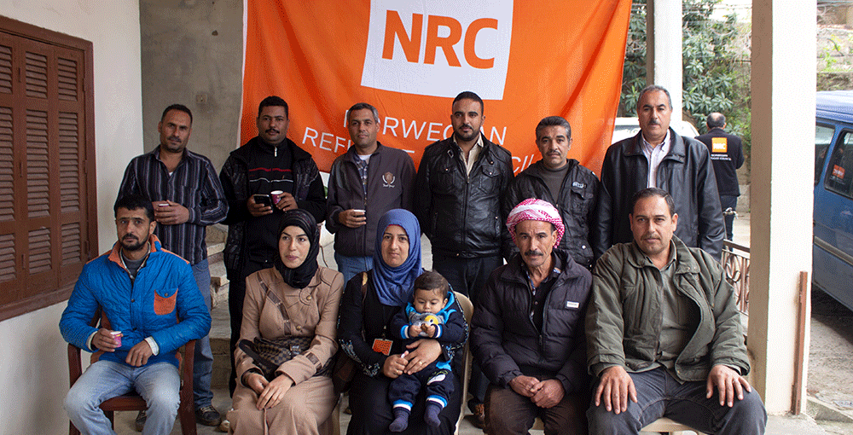
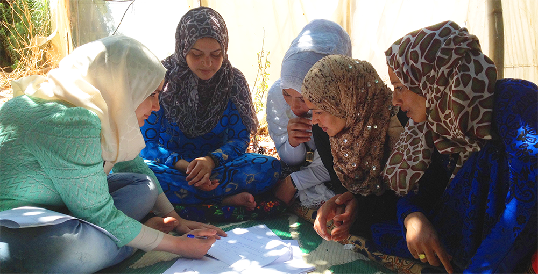
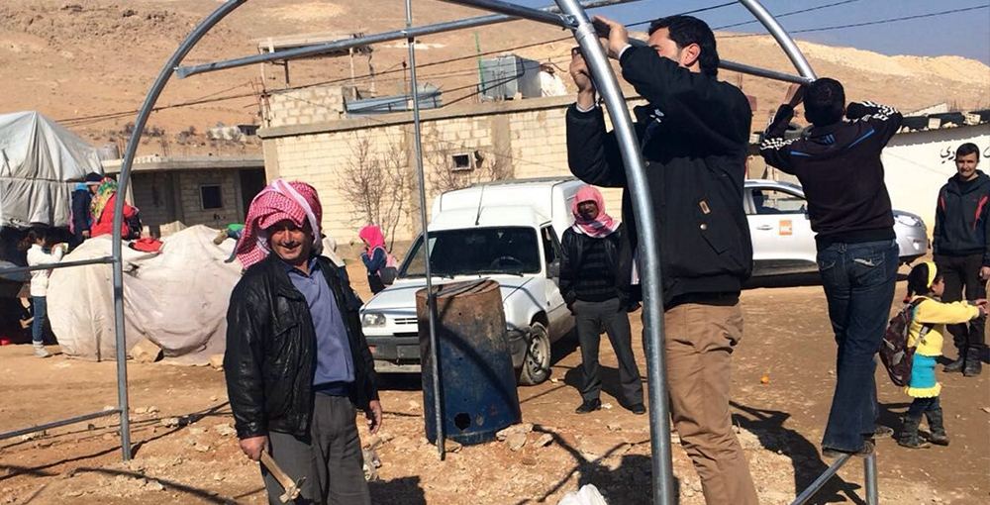
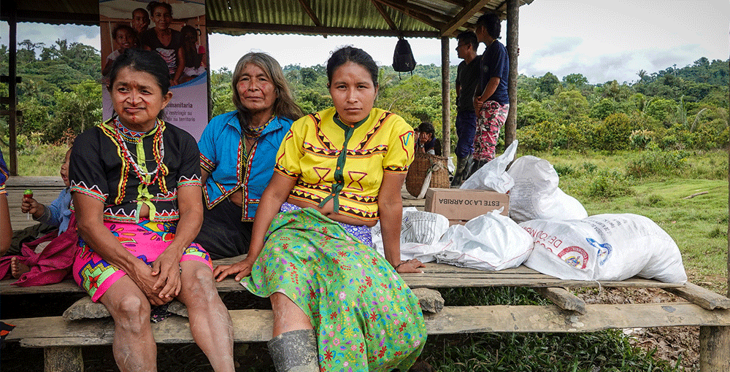
What can you find inside the toolbox?
Train your team
Build/support representation structures
Women’s Coordination Network
Community led Projects
Social and Cultural Influence Analysis

Slide 8
https://cct.nrc.no

Slide 9
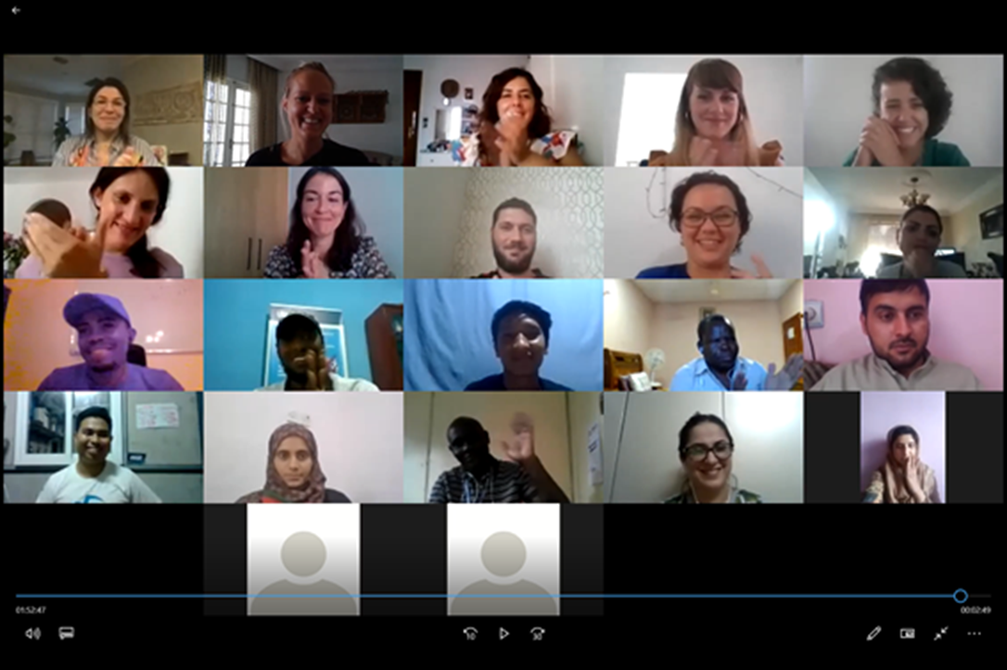
Pilot Online ToT in Community
Coordination

Slide 10
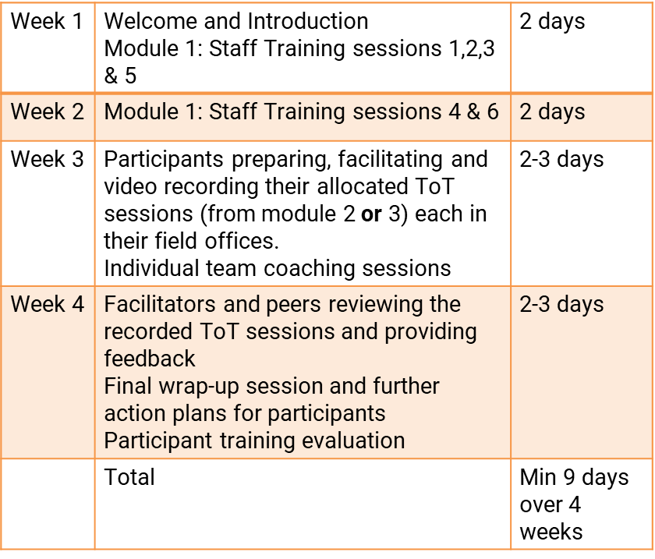
Online ToT
Outline

Slide 11

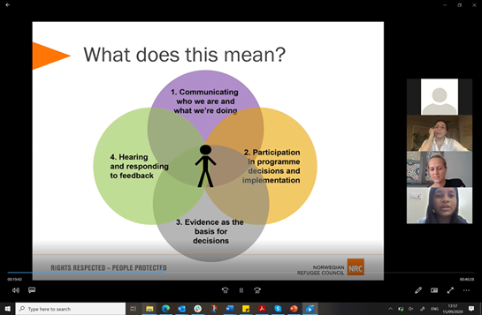
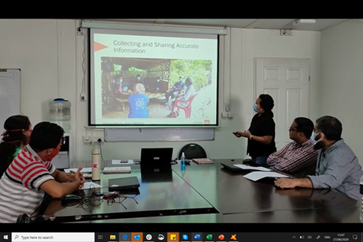
Methodology

Slide 12
ToT feedback
“As I spend most of my time in the field, I feel that the tools for supporting community structures are very useful.”
“The session on community structures was very useful for me, as I will apply it in my current context.”
“For me, this subject is really important in the region where I work, and I have never participated in a training with this subject.”
“Super relevant because I have spoken directly about my day by day work in spontaneous settlements.”

Slide 13


The CCT is developed in collaboration with and support from IOM and BPRM

